Slide 1


Slide 2



Course: Python Projects - I
Project On: Child Nutrition Calculator

Slide 3
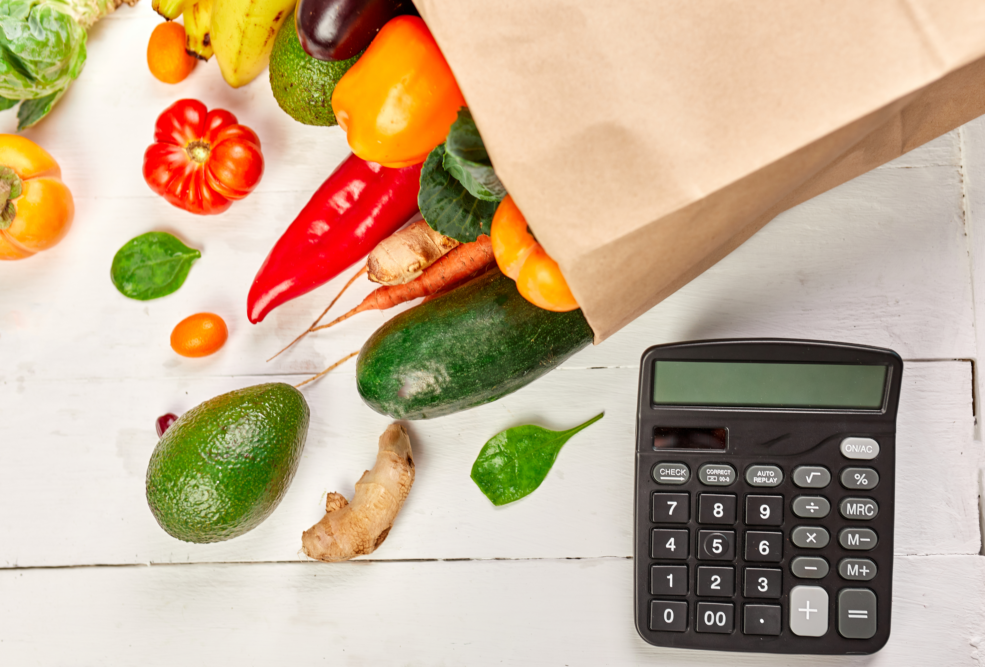
Problem Statement
Let’s put ourselves in the shoes of a childcare provider.
As a childcare provider, we have an essential role in children’s lives by helping them learn and grow. You help children get the nourishment and energy they need to learn and grow by providing healthy meals.
Also, keep in mind that preschoolers who eat a variety of healthy foods and play actively several times every day are less likely to be overweight or obese.

Slide 4
Additional Conditions
Create a child nutrition calculator based on the following rules:
Calculator should be able to store the details of the child such as the name, age, gender, height and weight.
Calculate the BMI of the child using the standard BMI formula.
Display the minimum daily calorie requirement based on the age. Use the below criteria to display the same:
Age b/w 0-2 years: 800 calories
Age b/w 2-4 years: 1400 calories
Age b/w 4-8 years: 1800 calories

Slide 5
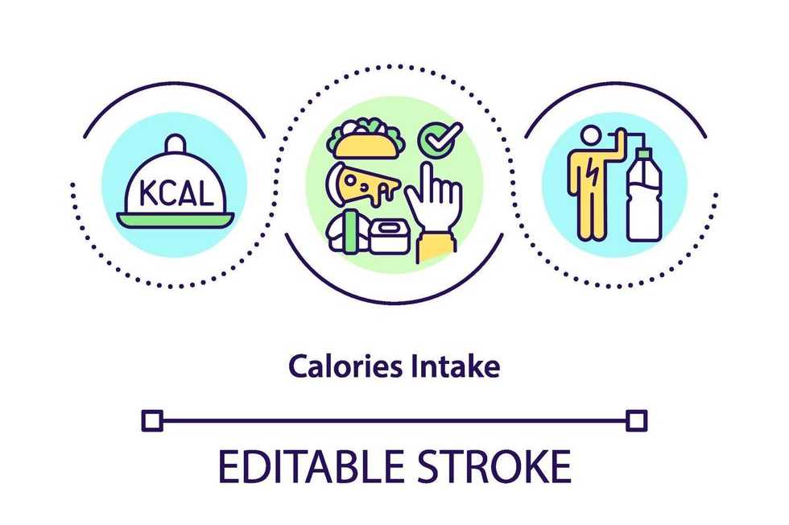
Additional Conditions
Additional Conditions Cont’d
Take as input what that child has eaten throughout the day and in what quantities.
Calculate the daily calorie consumption based on the following criteria:
Next, compare the daily consumption with the recommended value and print if the child is under-nourished or not.
Milk: 100 cal/ 100g
Egg: 155 cal/ 100g
Rice: 130 cal/ 100g
Lentils: 113 cal/ 100g
Vegetable: 85 cal/100g
Meat: 143 cal/ 100g

Slide 6
Data for BMI Calculations
BMI = weight/(height**2)*703
Weight in pounds and height in inches
BMI | BMI Categories
<16 | Severely Underweight
>=16 and <18.5 | Underweight
>=18.5 and <25 | Healthy
>=25 and <30 | Overweight
>=30 | Obese

Slide 7
Test Case
Test Case:
Input:
Name: Peter Parker
Age: 7
Height: 45 inches
Weight: 60 lb
Calorie Consumption
Milk: 300g
Vegetables: 300g
Meat: 200g
Lentils: 100g
Egg: 300g
Rice: 300g
Output:
BMI of Peter Parker is 20.82 and he (she) is healthy.
The daily calorie consumption of Peter Parker is 1809 and he (she) is not undernourished.

Slide 8
#LifeKoKaroLift
All The Best!

